Slide 1
PROJECT MERIT BATCH 1) Ritik Samanta : 17302B0028 2)Avdhoot Ambal : 17302B0009 PROJECT GUIDE : Ms. Prachi Mahajan
PROJECT TITLE:
LOW COST HEALTH MONITORING SYSTEM

Slide 2
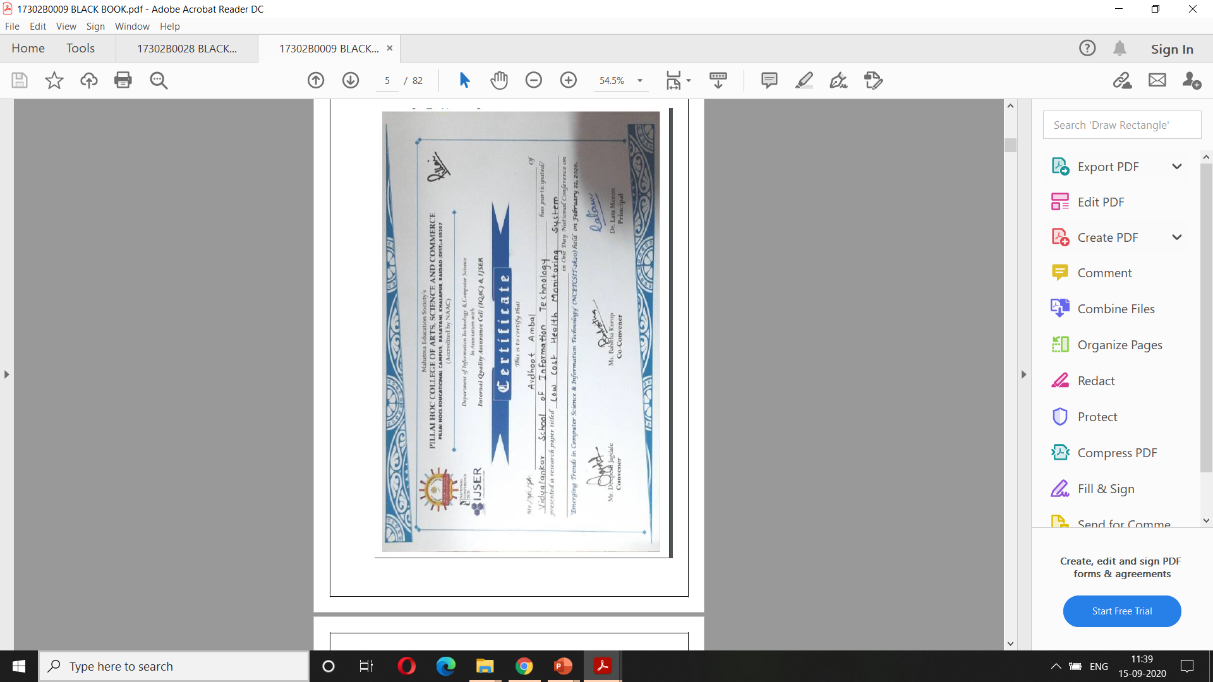
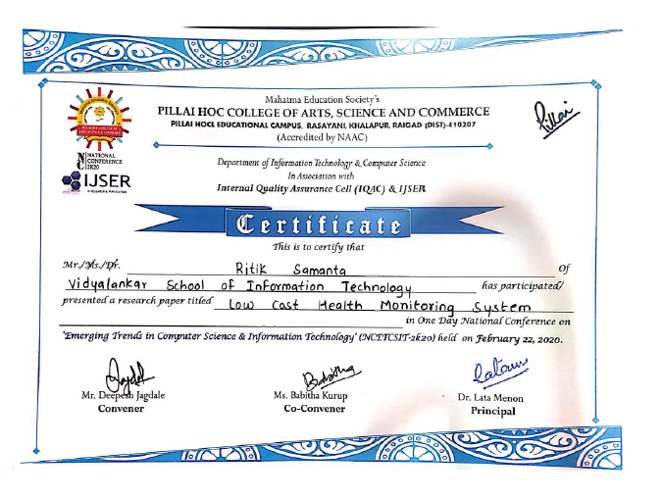
Research Paper presented in NCETCSIT-2020

Slide 3
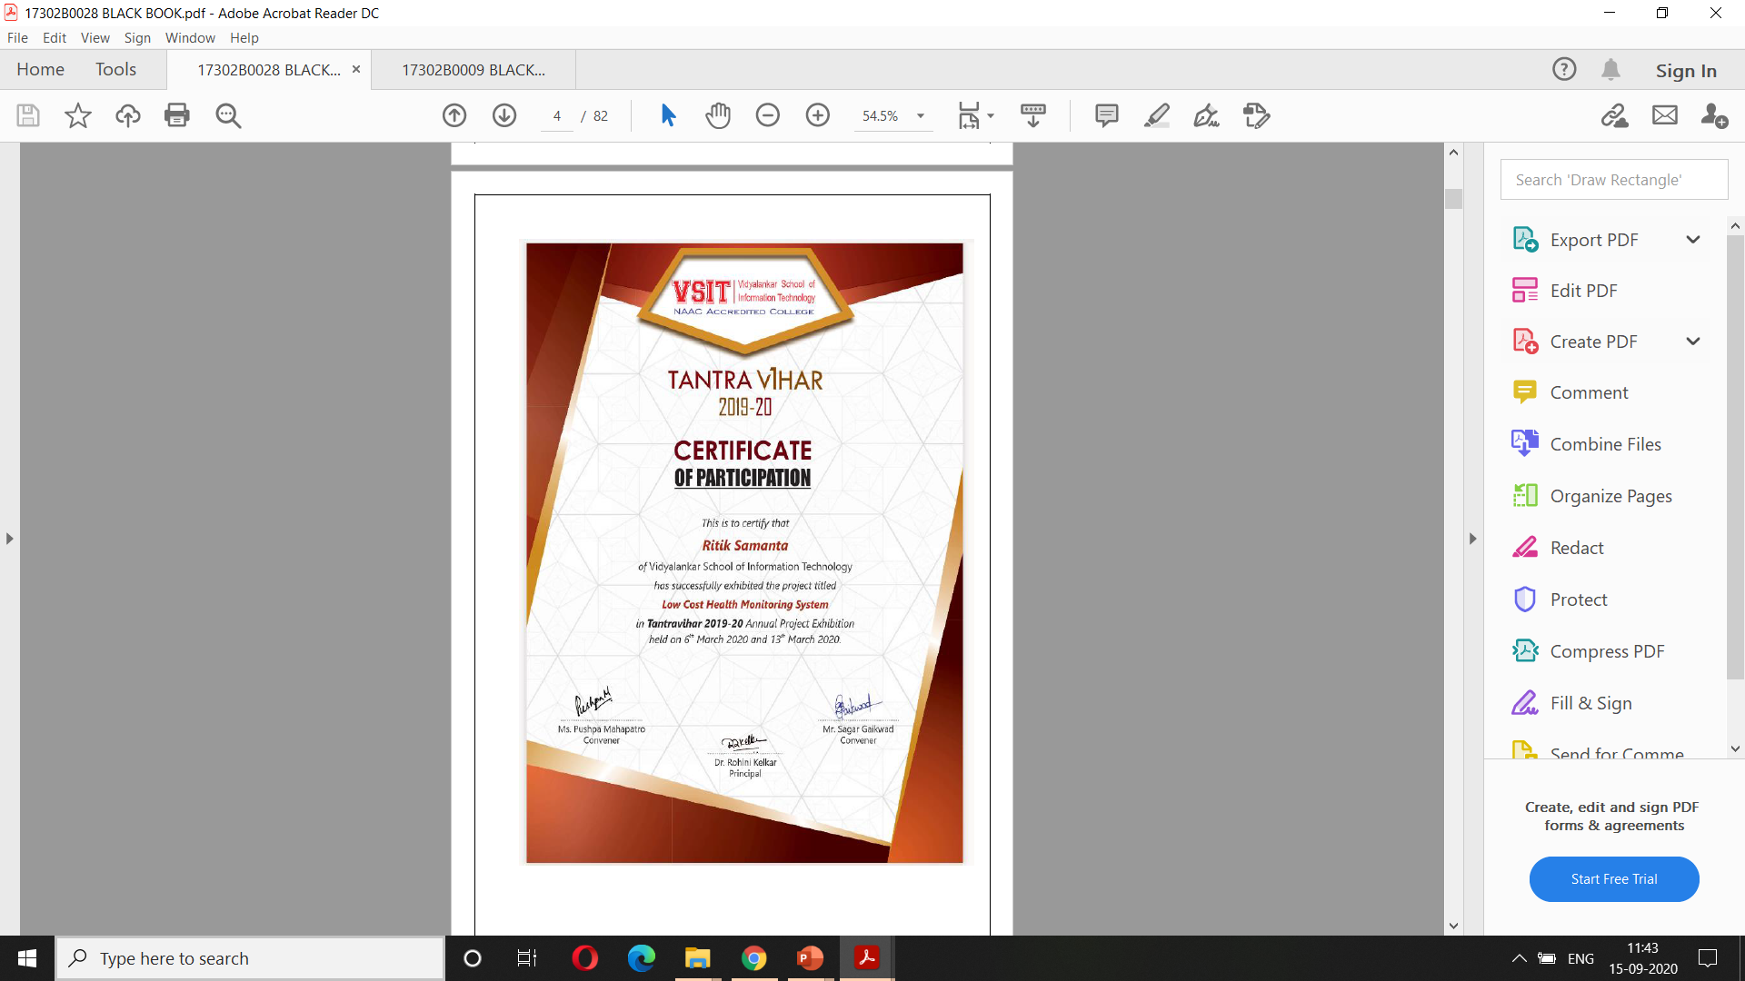
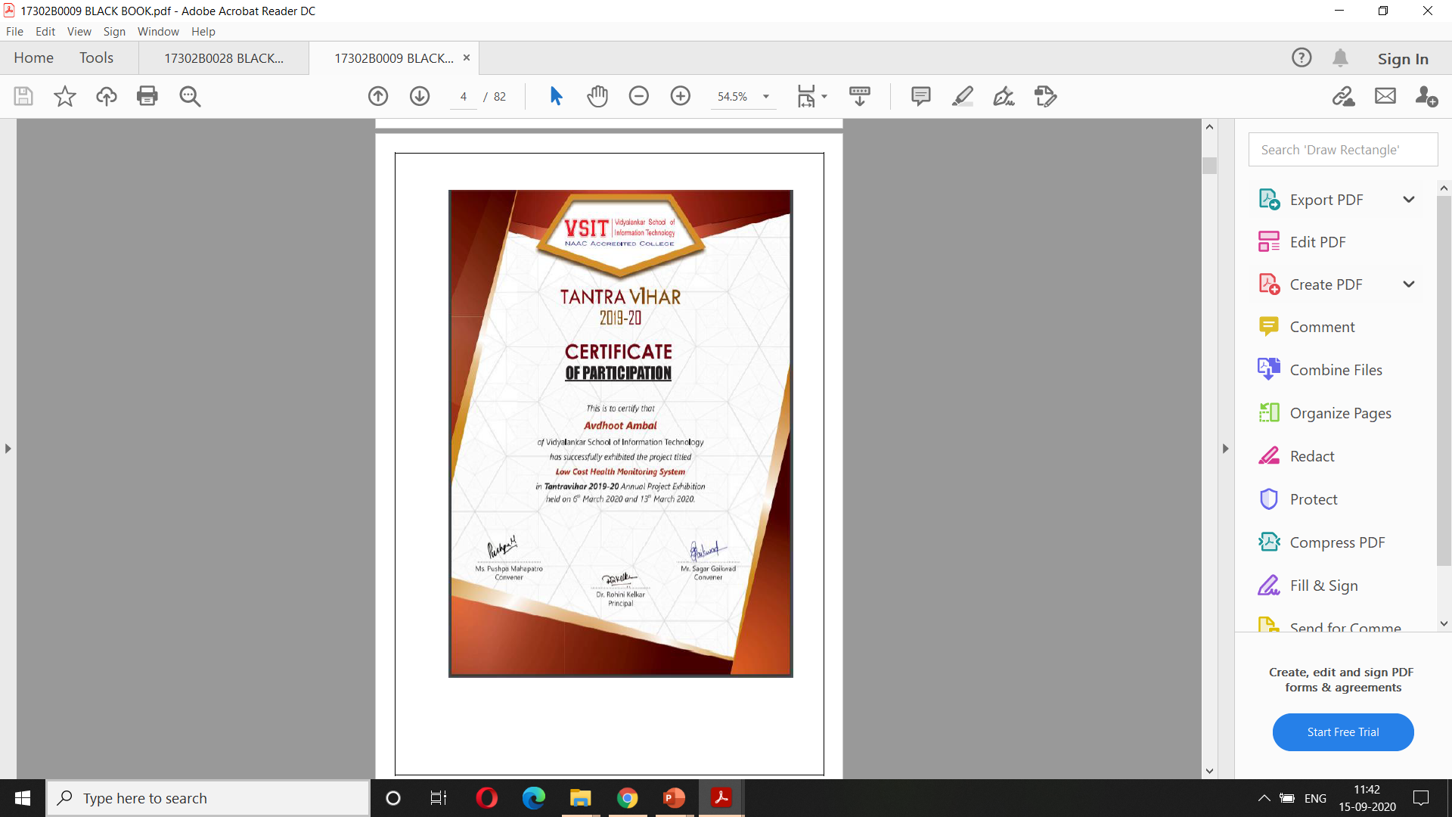
Project presented in TANTRAVIHAR 2019-20

Slide 4
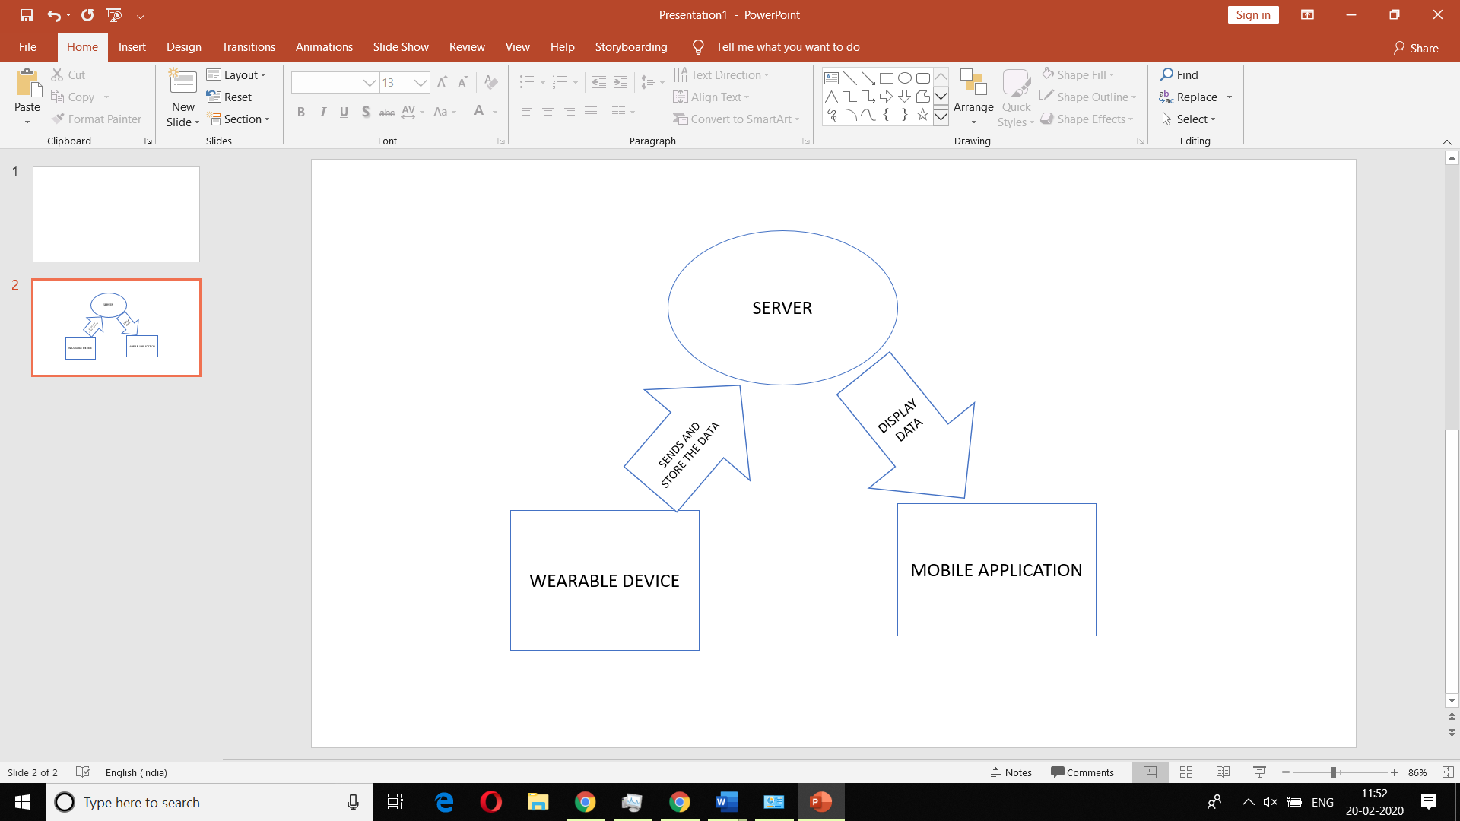
“Low Cost Health Monitoring System” is an embedded system which is combination of hardware device with sensors connected to it to monitor readings from the individual wearing it and using internet we send the data to a server and then fetch those readings in the application to display it. SYSTEM ARCHITECTURE
H

Slide 5
The system is made up of three components namely Hardware, Server, and Mobile App.
The hardware is the wearable device that is worn by the user.
The data from the wearable device is sent to the server over the Internet.
The server then pushes the data to the mobile app.
The data in the mobile app can be checked by the user of the wearable device himself or any other authorized user who wishes to remotely monitor the health of the user of wearable device.

Slide 6
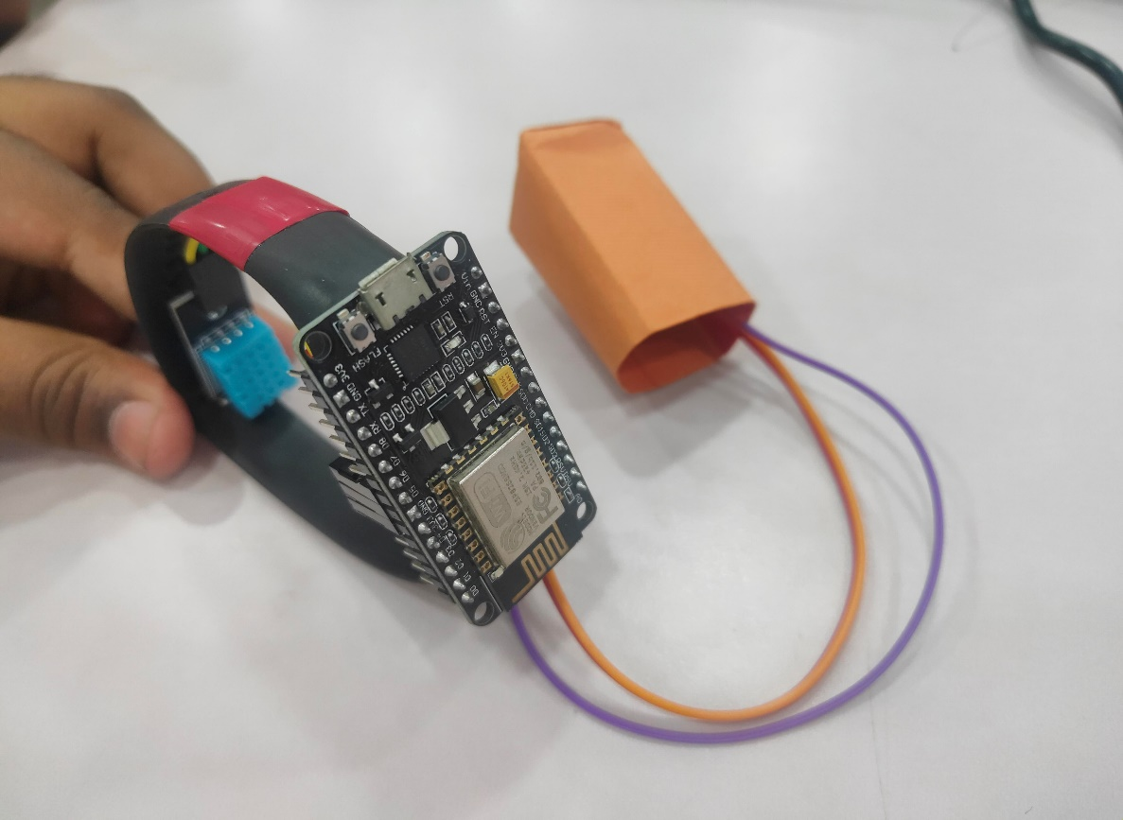
HARDWARE
The wearable device consists of ESP8266 NodeMcu 12E Development Board with sensors APDS9008–Pulse Sensor Module and Temperature Sensor connected to it and a small sized power bank is been used for the power supply.
The coding for the hardware is done through Arduino IDE. The sensors sense the data every fifteen seconds and send it to the server. The design of the device makes it light weight, portable and handy.

Slide 7
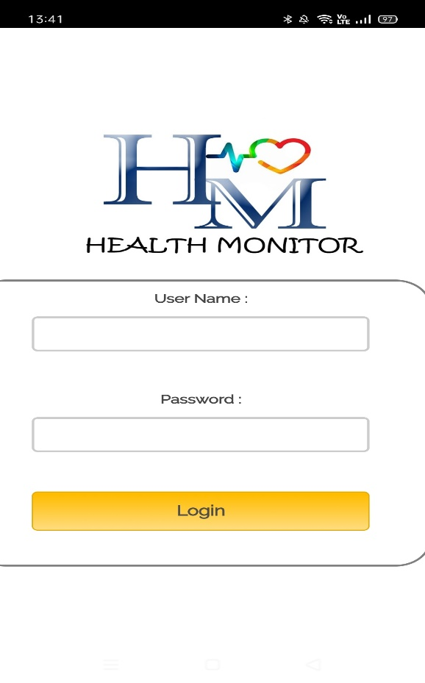
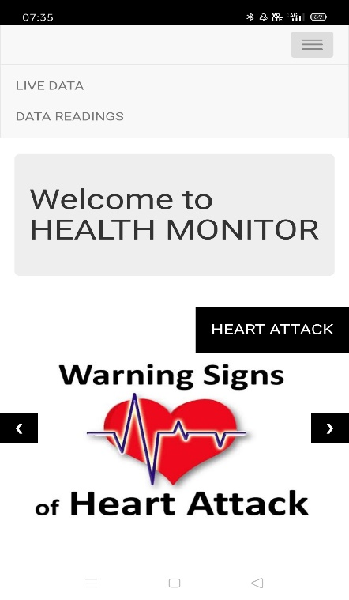
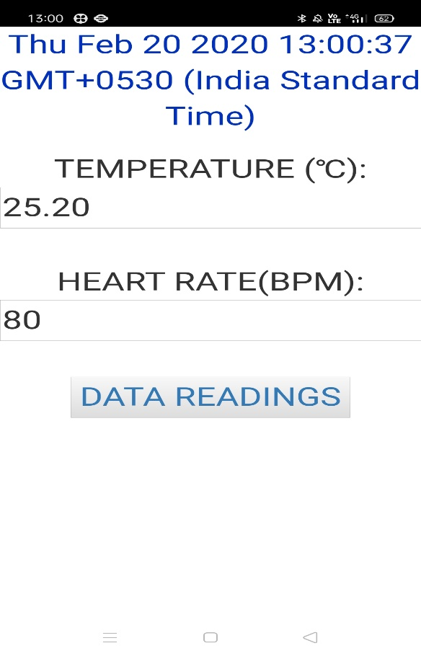
MOBILE APPLICATION
Only authorized users will be able to use the mobile app. The users will be the persons wearing the device by themselves or they will be someone in the family who wish to monitor the health of the person wearing the device.
the home screen in which two options are available namely Live Data and Data Readings. Live Data shows the current readings whereas Data Readings fetches the previous readings from the server and displays them.

Slide 8
Conclusion The system provides a real time solution of monitoring health of self or any family member with reliability. The previous data readings also facilitate tracking and monitoring health. With being low cost the system is very simple and easy for anyone to handle it.
FUTURE SCOPE
The system can be made to track more parameters in addition to the current ones. Additionally, the GPS module can be used to identify the exact location of the person and if necessary timely help can be provided to the person.

Slide 9
REFERENCES
https://github.com/Hanappy/pulse_sensor?files=1
https://ubidots.com/blog/connect-your-esp8266-to-any-availablewi-
fi-network/
https://www.instructables.com/id/ESP8266-Communication-With-
Server-and-ESP8266/
https://www.how2electronics.com/pulse-rate-monitoring-overinternet-
using-thingspeak/
https://www.esp8266.com/viewtopic.php?f=32&t=10996
https://github.com/Isha2109/IOT-Heath-Monitoring-
System/tree/Isha2109-patch-1?files=1
https://github.com/nothans/iot-debugger
https://community.thingspeak.com/forum/thingspeak-api/javascript-to-display-last-value-of-a-channel-on-web-page/

Slide 10
THANK YOU

